Slide 1
KNOW YOUR PIGMENT WHAT IS SAFE?
MYTIA STORY - Vice President & Senior Chemist of Li Pigments

Slide 2
SAFE QUALITY PMU
SINCE 1992
EYEBROW LIP SCALP SKIN AREOLA
ARTIST
SERIES
PRE CARE AFTER CARE CONTINUOUS CARE ACCESSORIES
WWW.LiPIGMENTS.COM

Slide 3
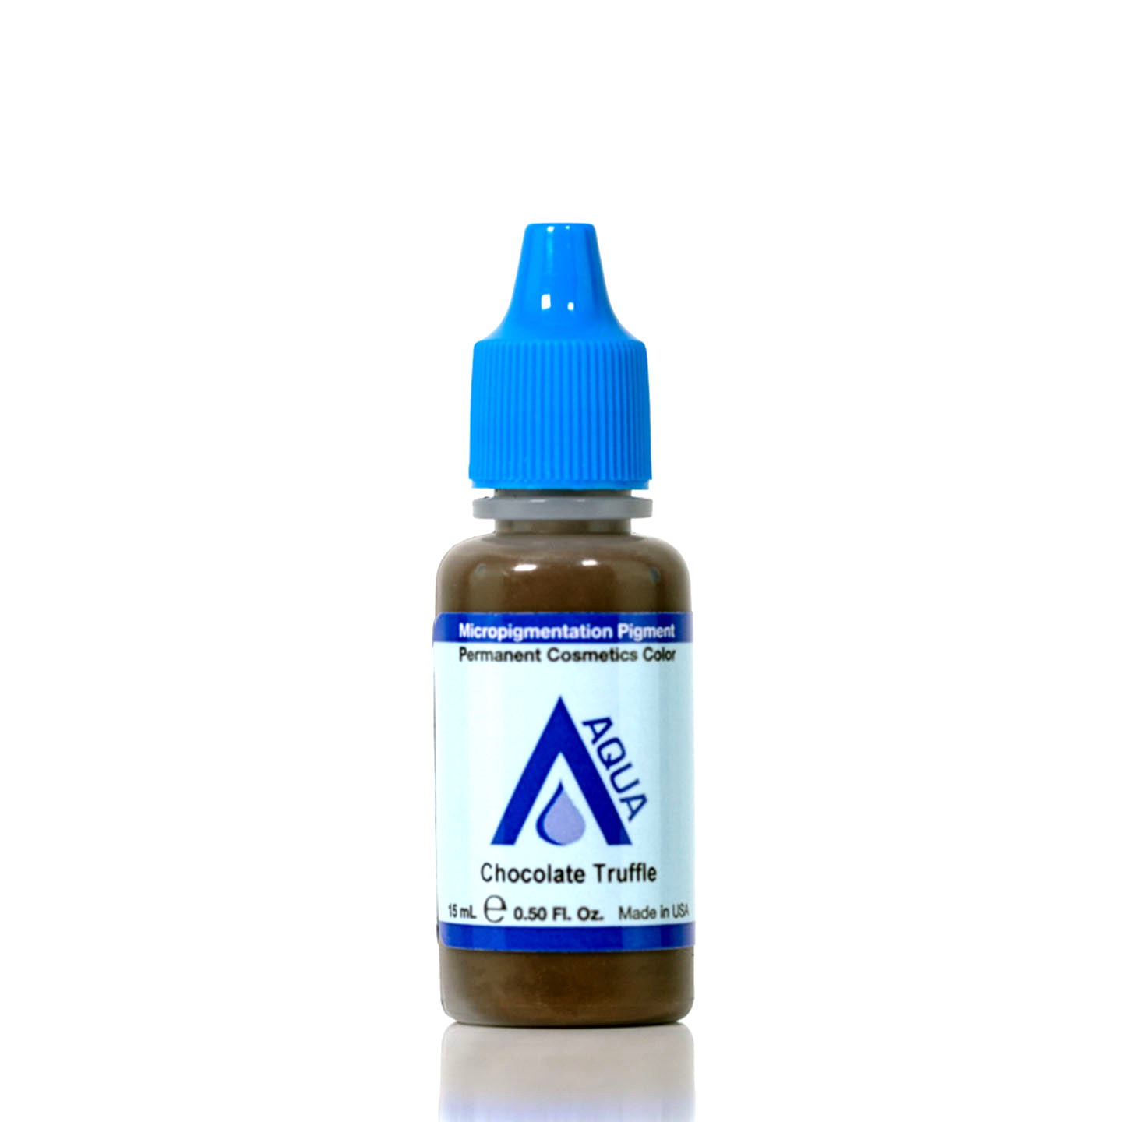
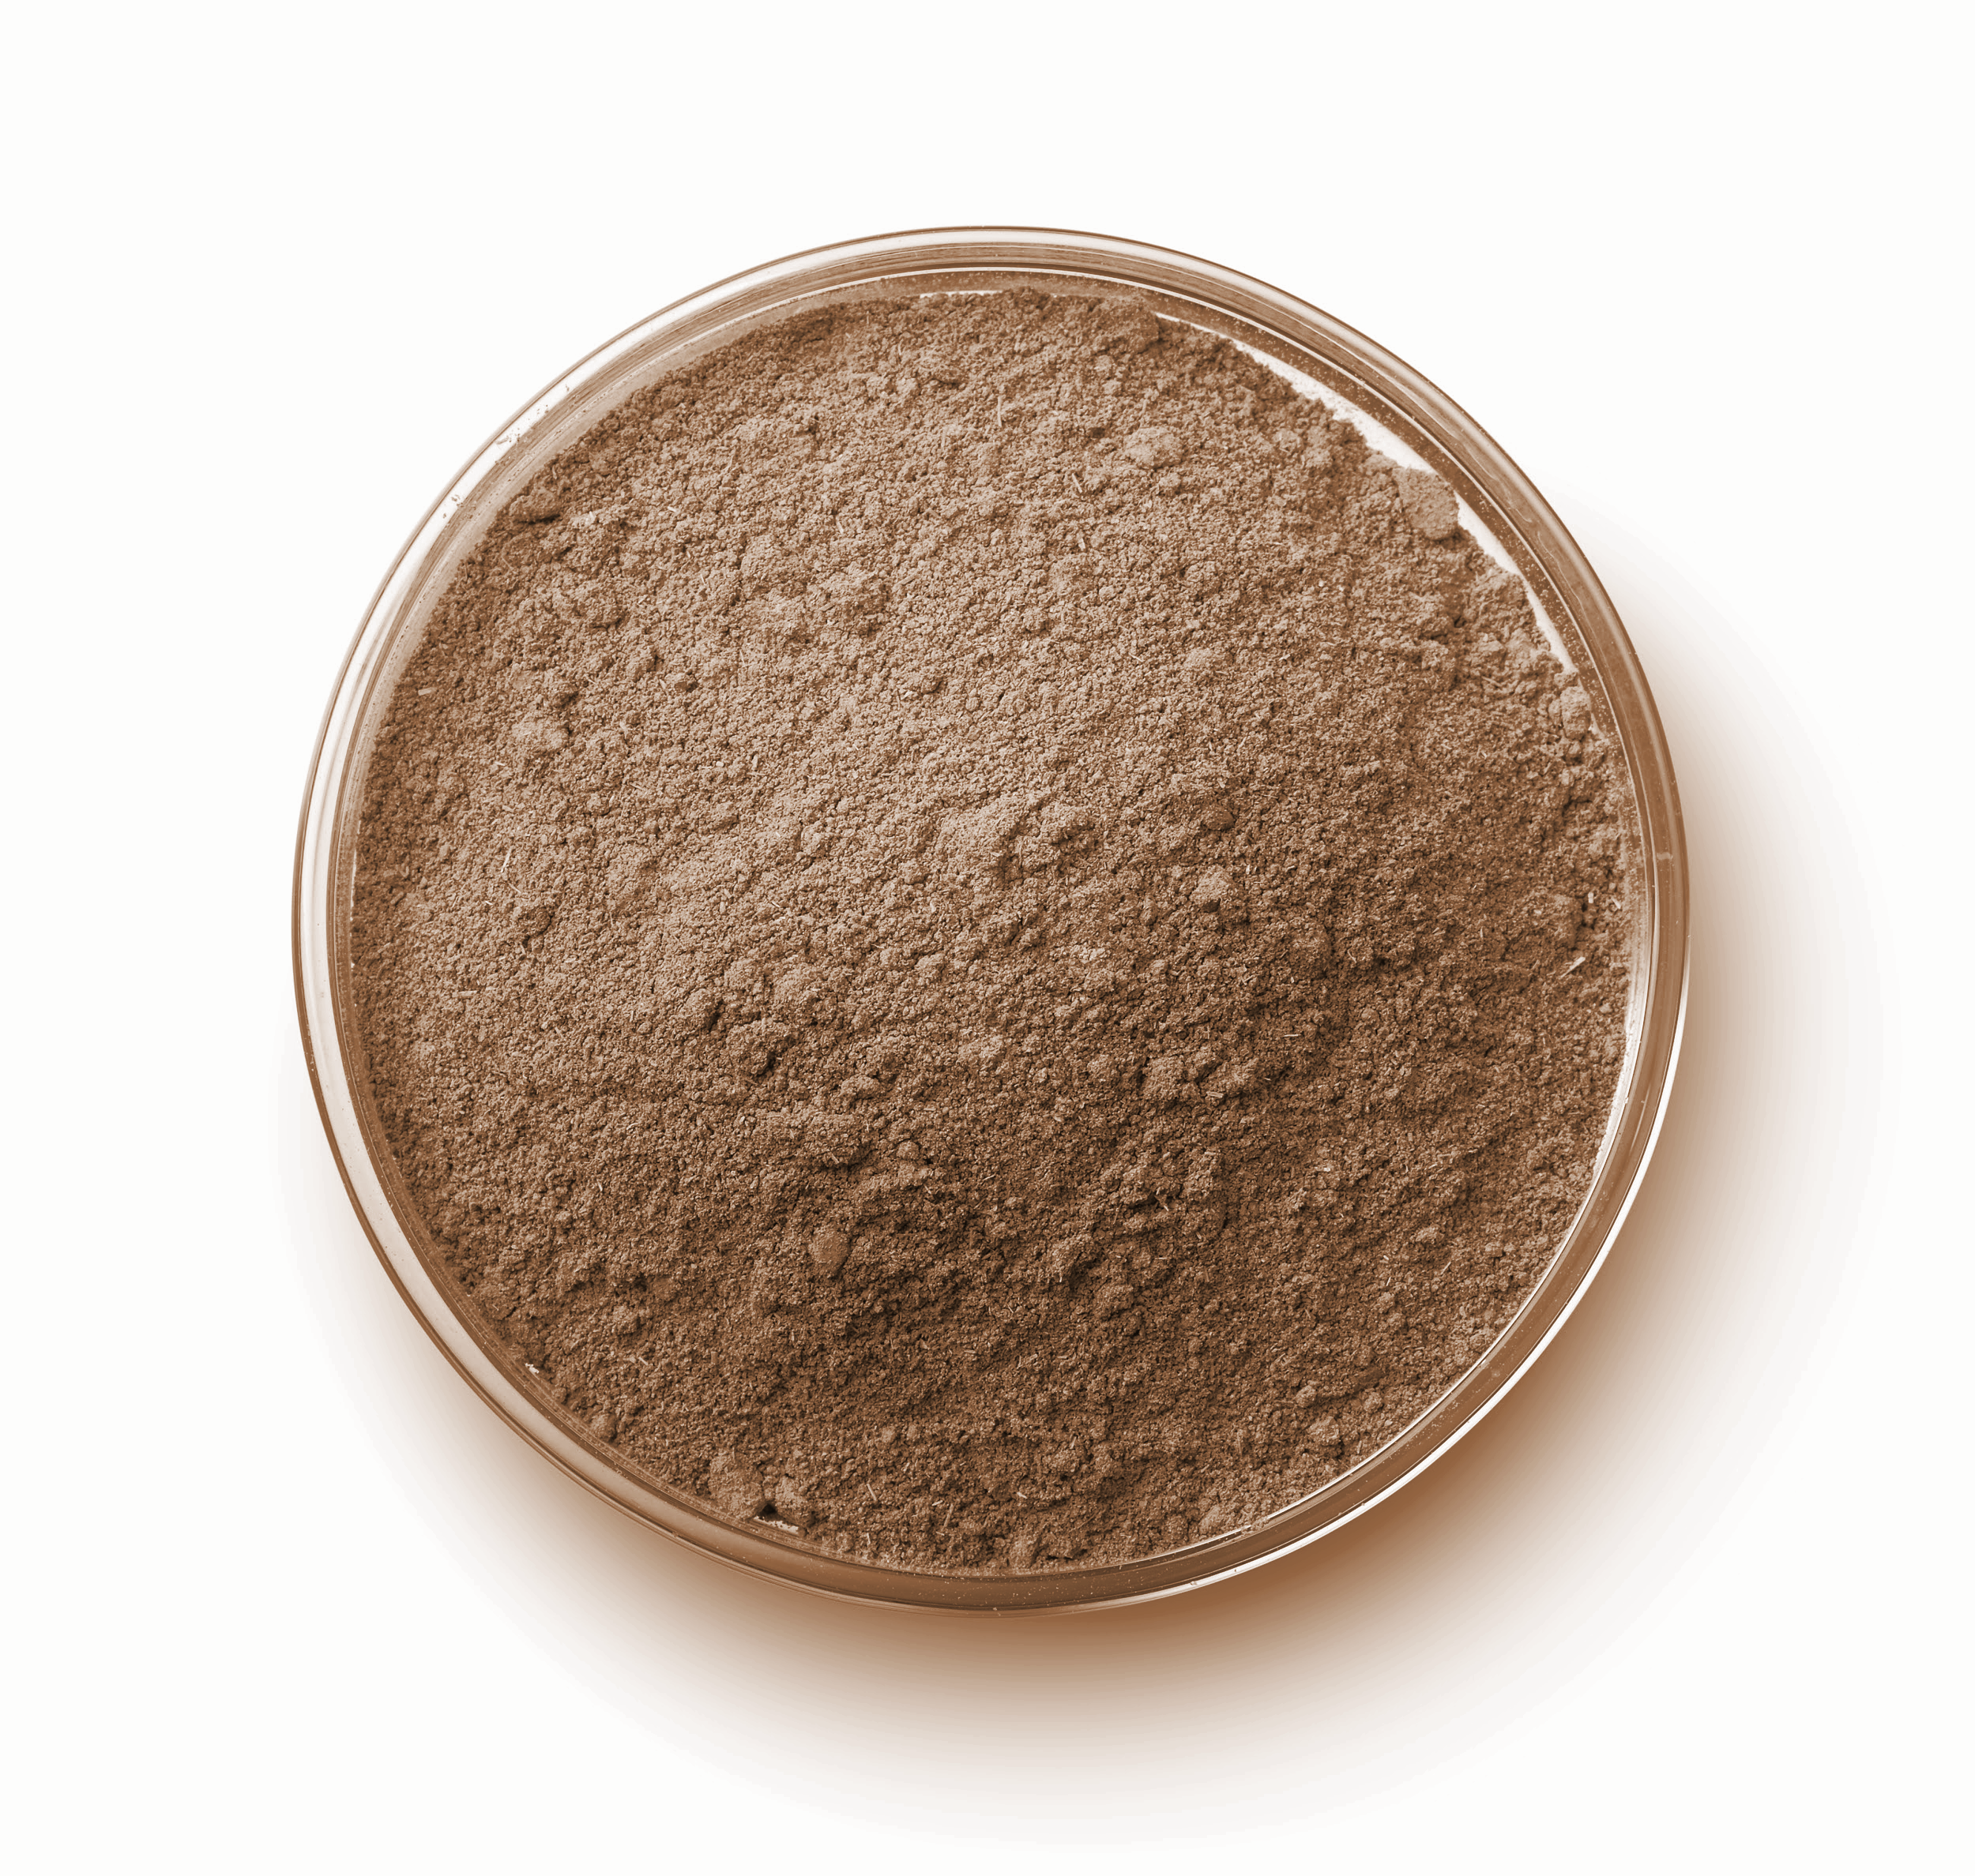
PIGMENT BASICS
PIGMENT
CARRIER(S)
CLORANT(S)
=
+
+ other ingredients
WWW.LiPIGMENTS.COM

Slide 4
MANUFACTURING PROCESS
Raw Material Selection
Raw Material
Receiving
Raw Material
Storage
Production
Packaging
Sterilization
Product Testing
Product Storage
WWW.LiPIGMENTS.COM

Slide 5
WHAT IS SAFETY IN PMU?
Optimal ingredient selection is void of impurities which may cause adverse reactions.
Raw Material Selection
Raw Material Verification
Raw Material Storage
Purification & Sterilization
Production
This applies to Manufacturing & Artistic Application
WWW.LiPIGMENTS.COM

Slide 6
DESCRIBING COLORANTS
IDENTITY
CI or CASRN
SOURCE
NATURAL or SYNTHETIC
USE
TATTOO or PMU
WWW.LiPIGMENTS.COM

Slide 7
COLORANT IDENTITY
CI NUMBER
CAS NUMBER
UNIQUE TO COLORANTS
IDENTIFIES ALL SUBSTANCES
C.I. 77891
13463-67-7
CI FOR TITANIUM DIOXIDE
CAS FOR TITANIUM DIOXIDE
WWW.LiPIGMENTS.COM

Slide 8
COLORANT TYPE
ORGANIC
INORGANIC
Simultaneously Contains Carbon (C), Hydrogen (H), and Oxygen (O)
Doesn’t simultaneously contain C, H, & O
Made by living things
Can be found in living things
EXAMPLES: wood, grass, diamonds, petroleum
EXAMPLES: oxygen, gas, metals, rocks, water
WWW.LiPIGMENTS.COM

Slide 9
PROPERTIES OF A COLORANT
Each colorant is a unique molecule, that has areas of measurement & descriptions of its properties.
Fastness (Light, Chemical)
Brilliance & Brightness
Particle size & shape
ALL of these properties assists in the design of the final pigment.
WWW.LiPIGMENTS.COM

Slide 10
COLORANT SOURCE
NATURAL
SYNTHETIC
PRODUCED BY NATURE
WITHOUT HUMAN INTERVENTION
PRODUCED BY HUMANS
MAY UTILIZE CHEMICAL STRUCTURES NOT FOUND IN NATURE
WWW.LiPIGMENTS.COM

Slide 11
SOURCE REMINDER
SYNTHETIC compounds CAN derive from
a NATURAL occurring chemical structure
Synthetic or Natural, the material source has no relation to it being ethically sourced.
WWW.LiPIGMENTS.COM

Slide 12
VEGAN & CRUELTY FREE
The perfect, cruelty-free way to enhance any feature.
Pigments can be PETA Certified
No animal by-product ingredients
Never tested on animals
‘Enhancements should do no harm’ whether applied topically or implanted.
WWW.LiPIGMENTS.COM

Slide 13
Q: TATTOO & PMU PIGMENTS ARE DIFFERENT?!
Although the application of body tattoos and PMU may be similar, the formulations may differ to accommodate procedure area.
WWW.LiPIGMENTS.COM

Slide 14
COLORANT USE
TATTOO / PMU
PROCEDURE AREA
TECHNIQUES & TOOLS
WWW.LiPIGMENTS.COM

Slide 15
PMU PROCEDURE AREAS
To best preserve the artistic application, the formulation must compliment the procedure area & technique.
Eyebrows
Eyeliner
Lips
Scalp
Skin & Areola
Manual/Machine, Needle Type, Technique, Style will all affect application
WWW.LiPIGMENTS.COM

Slide 16
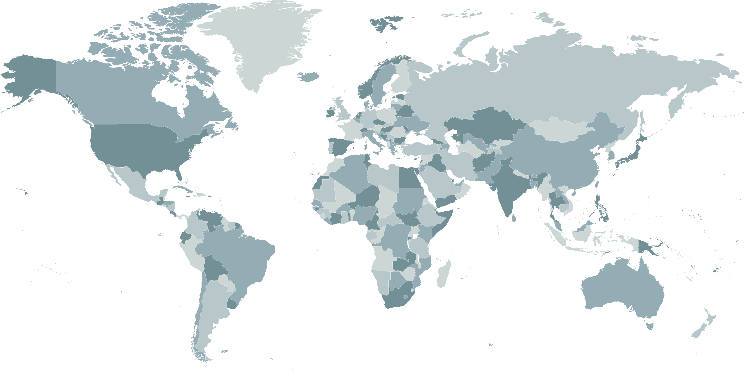
COMPLIANCE FOR
WORLDWIDE
DISTRIBUTION
RECENT CHANGES IN EU REACH
WWW.LiPIGMENTS.COM

Slide 17
Q: WHAT IS A REACH COMPLIANT PIGMENT?
An EU REACH Compliant Pigment is a pigment mixture that does not include any banned ingredients and adheres to the restrictions listed and advised on the RRS and are labeled according to CLP.
WWW.LiPIGMENTS.COM

Slide 18
DIRECTIVE 76/768/EEC, ANNEX VI PART I & II EU-RESOLUTION RESAP (2008)1
PRODUCT REGULATION 1907/2006 ANNEX XVII (REACH)
EU REACH Regulation only applies countries within the European Union.
Changes do not apply to the USA, Canada, or anywhere else in the world,
but may impact the decision-making entities regarding pigments and tattoo substances in the future.
WWW.LiPIGMENTS.COM

Slide 19
WHAT IS EU REACH?
Regulation of the European Union was adopted to improve human health & environmental risks from hazardous substances.
Updated Ban List
New Restrictions on Substances
These laws apply to all pigments & cosmetics sold in the EU
WWW.LiPIGMENTS.COM

Slide 20
REACH RESTRICTED SUBSTANCES
A list of restrictions on certain hazardous substances or mixtures for marketing and use on the EU market.
4000+ chemicals identified as hazardous or restricted
Restricted does not mean banned or unsafe
Restriction introduces new concentration limits on some substances
REACH Restricted Substances Finder (RRS Finder)
WWW.LiPIGMENTS.COM

Slide 21
REACH SVHC
An identified group of chemical substances of very high concern.
Very high concern does not mean controlled or banned
Information regarding its concern to the market
REACH SVHC Finder searches both the SVHC & RRS Databases
WWW.LiPIGMENTS.COM

Slide 22
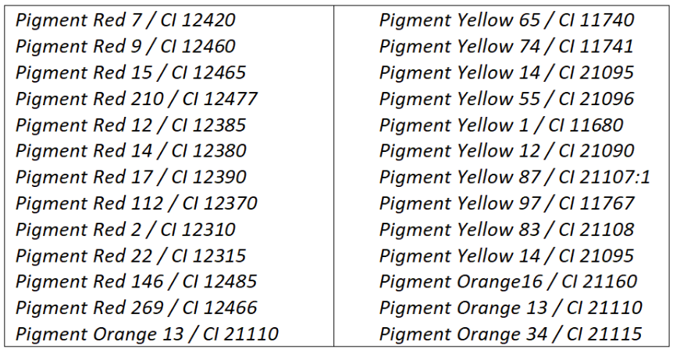
SOME BANNED EU REACH COLORANTS
Some colorants banned EU REACH ban
Sample list of banned colorants
WWW.LiPIGMENTS.COM

Slide 23
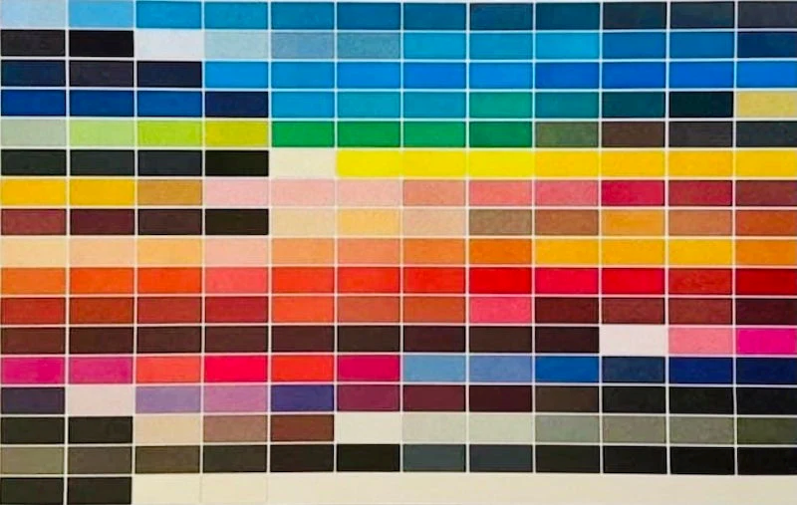
BEFORE EU REACH COLORANTS
Colorants available before EU REACH ban
Image: https://www.safethepigments.com/en
WWW.LiPIGMENTS.COM

Slide 24
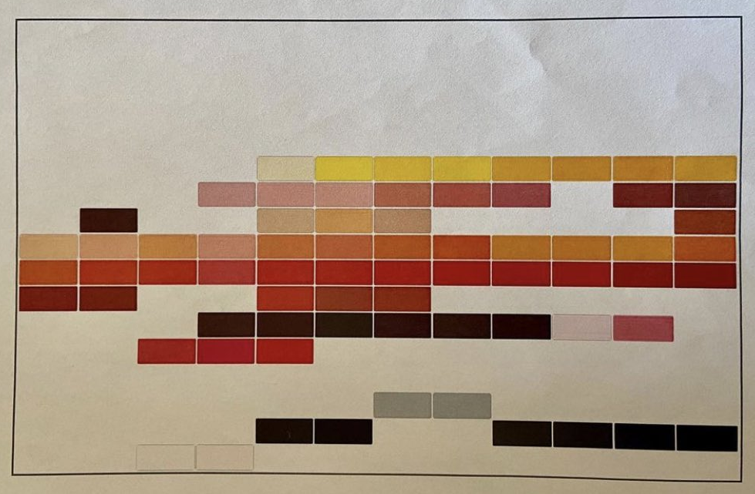
AFTER EU REACH COLORANTS
Colorants available after EU REACH ban
Image: https://www.safethepigments.com/en
WWW.LiPIGMENTS.COM

Slide 25
REACH CLP REGULATION
A mandatory harmonized classification, labeling, and packaging of hazardous substances.
International Chemical Identification
CLP Classification
Associated Pictograms
Signal Words
C&L Inventory Database
WWW.LiPIGMENTS.COM

Slide 26
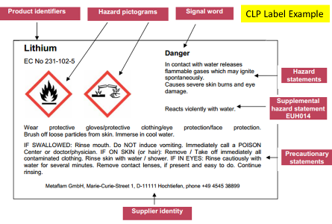
CLP INVENTORY DATABASE
WWW.LiPIGMENTS.COM

Slide 27
UPDATED LABEL LAWS
As a result of the EU REACH passing, there are additional label requirements that products must adhere to.
Additional labeling requirements
Package Insert Information via QR Code
All products sold in the EU, have new EU REACH Label regulations.
WWW.LiPIGMENTS.COM

Slide 28
KNOW YOUR LABEL
There is valuable information provided on each pigment label
Labels detail the weight, directions, manufacturing details, and more.
WWW.LiPIGMENTS.COM

Slide 29
Li REACH PRODUCT ANALYSIS
REGULATION EVALUATION
FORMULATION
EVALUATION
EU REACH PIGMENT PRODUCTION
TESTING & CERTIFICATIONS
WWW.LiPIGMENTS.COM

Slide 30
“WHAT DOES THIS MEAN FOR ME?”
WWW.LiPIGMENTS.COM

Slide 31
Q: DO YOU PURCHASE OR DISTRIBUTE PMU?
Knowing what changes are happening worldwide are key to supplying safe & compliant products.
WWW.LiPIGMENTS.COM

Slide 32
Q: DO I NEED TO WORRY ABOUT REACH?
EU REACH directly impacts countries within the European Union.
Although, countries outside of the EU do take REACH into consideration.
WWW.LiPIGMENTS.COM

Slide 33
Q: DO YOU SERVICE THE EU?
If you servicing the EU, inquire about REACH compliance with your pigment manufacturer.
WWW.LiPIGMENTS.COM

Slide 34
Q: DO YOU WANT TO GET MORE INVOLVED?
There are many local and global organizations to get involved with to understand changing laws of PMU in your area.
WWW.LiPIGMENTS.COM

Slide 35
IN THE KNOW
Helpful links to guide you in understanding more about ingredients and regulations:
USA
Society of Permanent Cosmetic Professionals (SPCP)
Association of Food & Drug Officials (AFDO)
EU
European Congress on Tattoo & Pigments Research (ECTP)
European Society of Tattoo & Pigment Research (ESTP Research)

Slide 36
SAFE QUALITY PMU
SINCE 1992
ARTIST
SERIES
PIGMENTS ARE COMPLIANT WITH DIRECTIVE 76/768/EEC, ANNEX VI PART I & II EU-RESOLUTION RESAP (2008)1 PIGMETNS ARE COMPLIANT WITH REGULATION 1907/2006 ANNEX XVII (REACH)
WWW.LiPIGMENTS.COM

Slide 37
THANK YOU
SPCP & ATTENDEES!
KNOW YOUR PIGMENT
WHAT IS SAFE?
PROMOTING PROFESSIONAL INDUSTRY EXCELLENCE FOR 31 YEARS!
SCAN ME TO RECEIVE THIS PRESENTATION IN YOUR EMAIL!

